Slide 1


Blockchain Based Crowdfunding

Slide 2
Group7(ABT)
Abdullah Alanazi
Aedah Alrehaili
Ayat Bu-Suhail
Bayan Alserhani
Thuraya Alrwaili
Instructor: Jonathan
Teaching Assistant: Xiaomei and Adam

Slide 3
TABLE OF CONTENTS
01
04
02
05
03
Important Terminologies
Why smart contracts?
Project overview
Project Goals
06
Why we pick this idea?
Demo

Slide 4
Important Terminologies :
Blockchain: is a list of continuously growing records called blocks. Each Block is linked to each other and they were secured using cryptography.
Crowdfunding: is an online money-raising strategy that began as a way for the public to donate small amounts of money to help creative people finance their projects.
Ethereum: is an open-source, public, blockchain based distributed platform and operating to featuring smart contract functionality.
smart contract: is a self-executing contract with the terms of the agreement between buyer and seller being directly written into lines of code.

Slide 5
Project overview
A crowdfunding smart contract where a project gets funded by raising amounts of Ether on the Ethereum blockchain. The project gets its value due to blockchain technology that helps verifying data from seekers and funders, eliminating dependence on third parties and speeding up the submission and disbursement of funds.

Slide 6
Why we pick this idea?
The need of a decentralized crowdfund now days since we are in the evolution of the web3.
More secure.
Fast to transfer the money to the clint
Encourage the investor to participate in the world’s future fund to create their idea throw this fund.
Easy way to share ideas in blockchain area.
Good investment to get ideas and raise money.

Slide 7
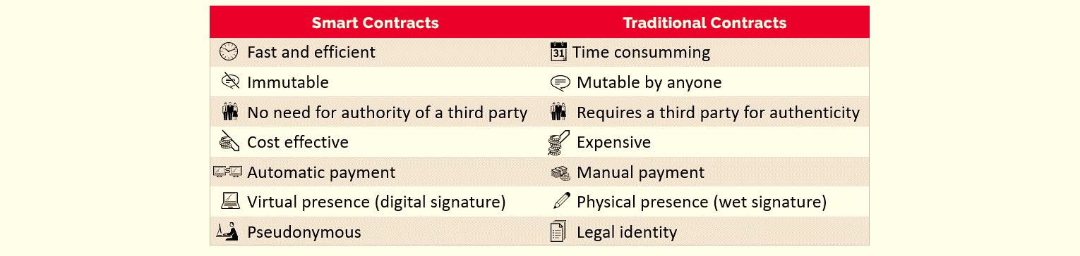
Why we choose the smart contracts?

Slide 8
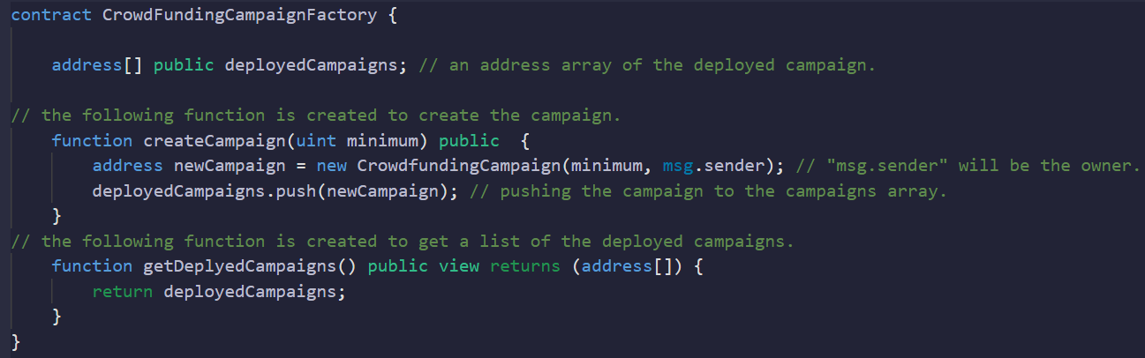
Project Goals:
1. Create the main contract which is the crowdFundingCampaignFactory

Slide 9
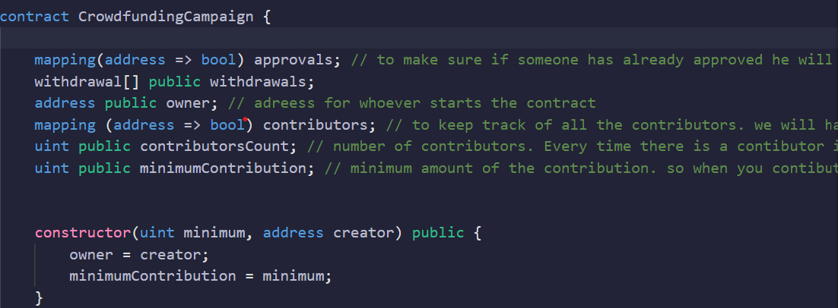
Project Goals:
2. create crowdfunding contract that allows anyone to get donations for calls.

Slide 10
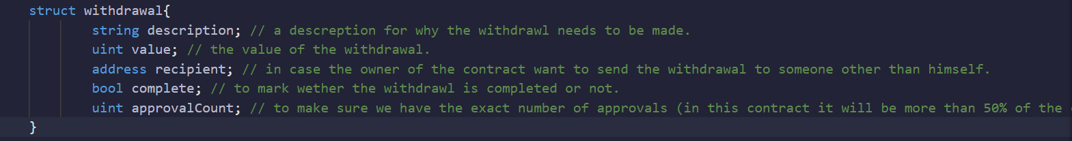
Project Goals:
3. Create a struct withdrawal that requests the raised amount and draws it

Slide 11
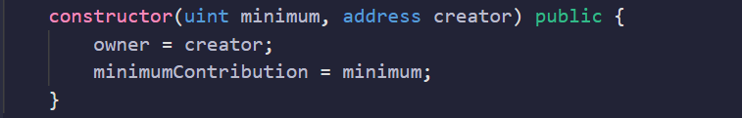
Project Goals:
4. Create constructor which has the minimum amount of the contribution and the address of the owner.

Slide 12
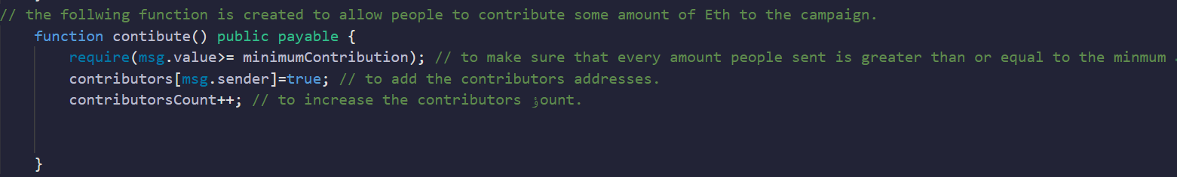
Project Goals:
5. Create contribute function which checks if the minimum contribution has been met.

Slide 13
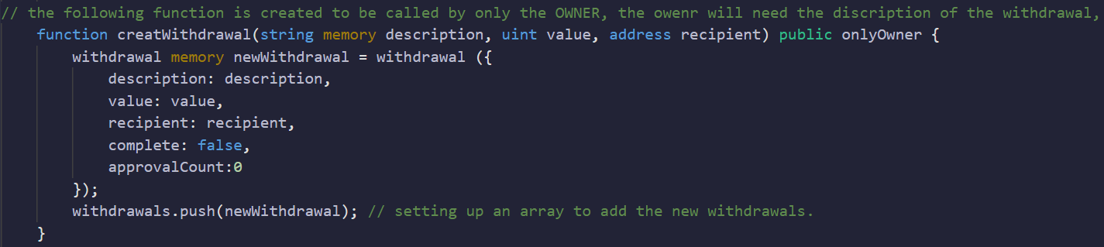
Project Goals:
6. create withdrawal function which allows users to create requests.

Slide 14
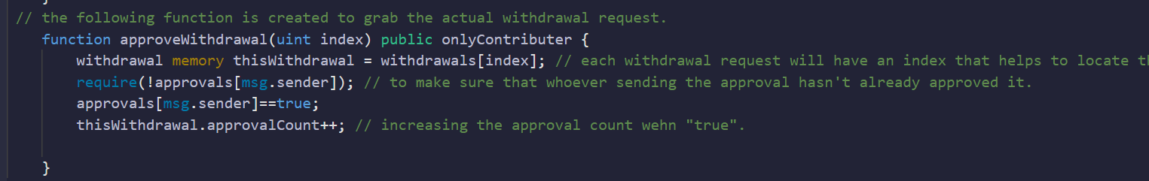
Project Goals:
7. create approval function that will grab the actual withdrawal request.

Slide 15
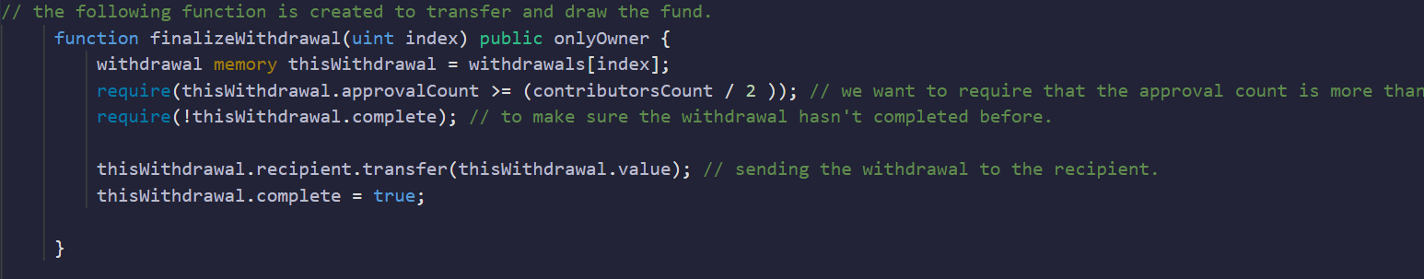
Project Goals:
8. Finalizing function that transfers the funds and draws it.

Slide 16
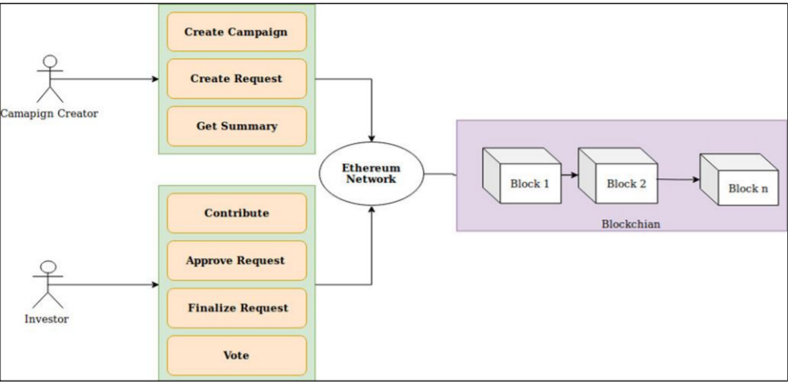
Working Model

Slide 17
Demo

Slide 18
Thank You
Any Question ?

Slide 19
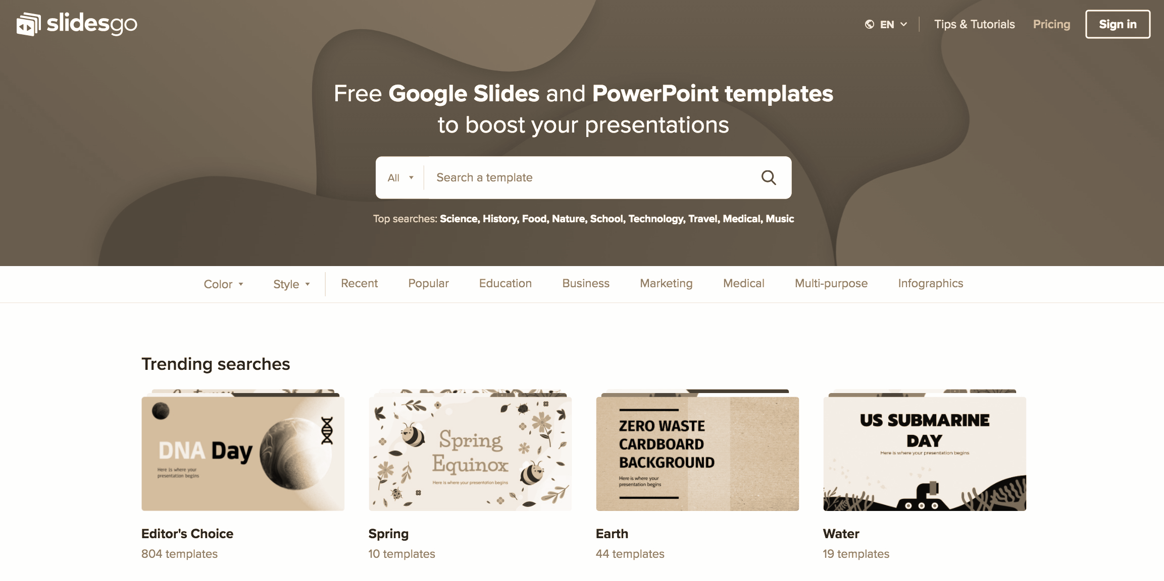


Resources
https://journals.indexcopernicus.com/api/file/viewByFileId/594400.pdf
https://github.com/akcgjc007/kick_U
https://www.researchgate.net/publication/342742097_Smart_Contract_and_Blockchain_for_Crowdfunding_Platform

